Slide 1
Public Health 101 Faculty YTJ Section-28
Presentation

Slide 2

Group-C Sujon Majumdar Azizul Tareq Farzana Urmi Mahi Zebin Al Mahmud Z. M. Zulkarnine

Slide 3
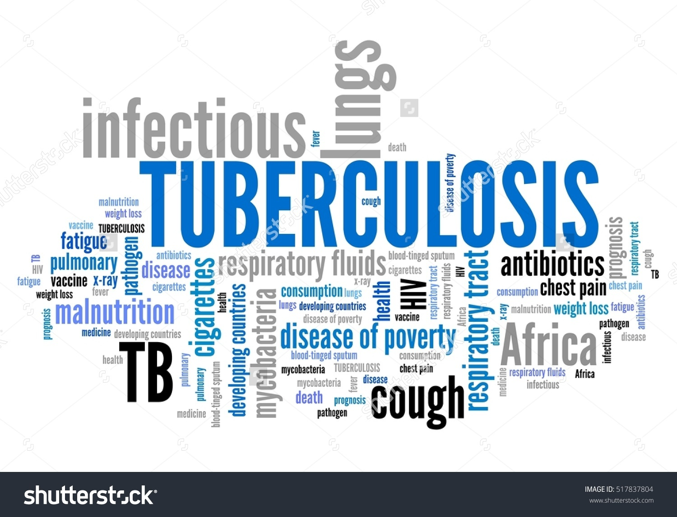
Tuberculosis
a deadly yet curable disease

Slide 4
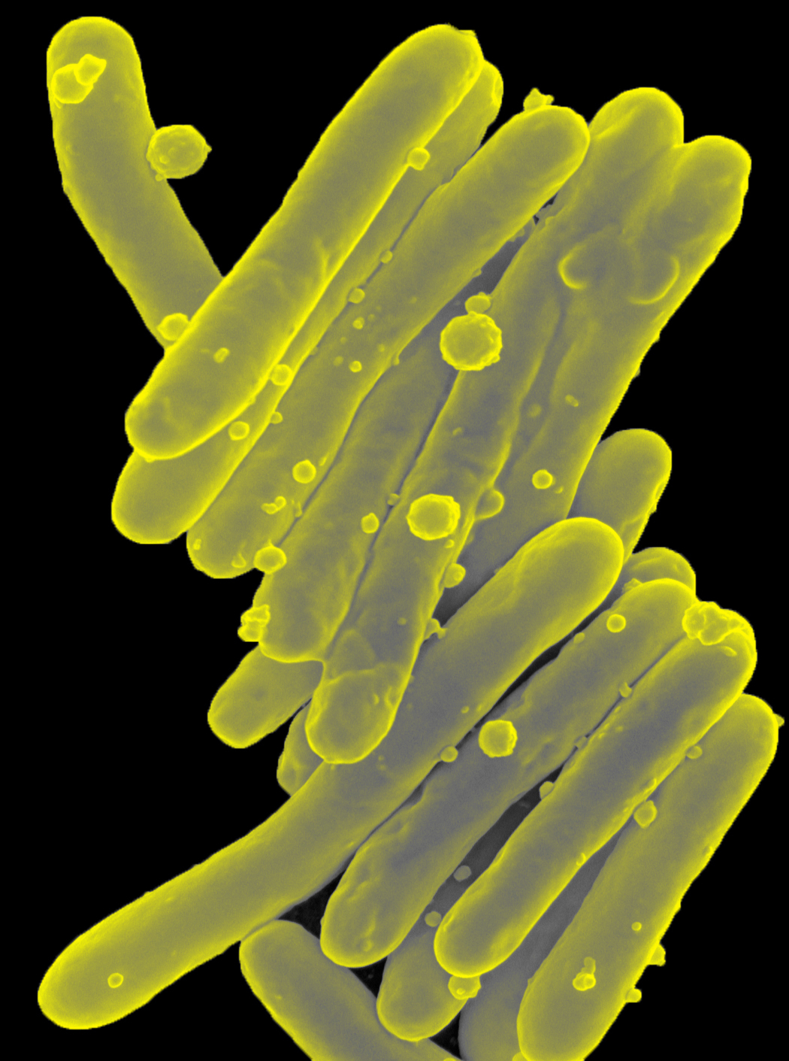
Introduction:- Tuberculosis or TB its commonly called , TB is a bacteria disease which in humans is usally caused by an organism called Mycobacterium tuberculosis TB infection spread through inhaling tiny droplets from the caughs or sneezes of an infected person , the bacteria released into the air . Typically , its attacks the lungs and also other parts of the body like-kidney,spine,brains
Microscopic image of a long, thin, rod-like bacteria. Colorized scanning electron micrograph of Mycobacterium tuberculosis.

Slide 5
Tuberculosis is the second biggest killer globally . In 2015 1.1 million people died cause of having TB.

Slide 6
TyPes of tb
there are two types of tb infection
1.latent & 2.active
Latent :-
in latent, the bacterium that causes tb, remains in the body in an
inactive state. They cause no symptoms and are contagious. Further,
they can become active.
Active :-
In some people, tb bacteria destroys the immune systems defenses
and begin to multiply, resulting in the progression from latent tb
infection to tb diseases.

Slide 7
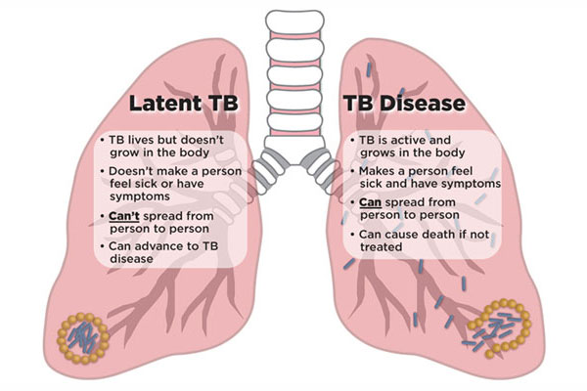
The cause of TB is the Mycobacterium tuberculosis bacteria . It is spread through the air through the saliva(sneezing, coughing) of an active TB infected person.
LATENT TB: They are infected with M. tuberculosis, but do not have TB disease. The bacteria is inactive and not contagious. It can only be detected through tuberculin skin test or TB blood test.
ACTIVE TB: In some people, TB bacteria destroys the immune system’s defenses and begin to multiply, resulting in the progression from latent TB infection to TB disease.

Slide 8
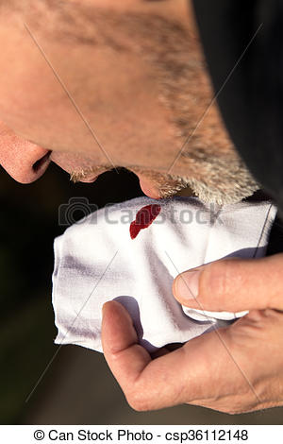


SYMPTOMS
Coughing sometimes with mucus or blood
Chills
Fatigue

Slide 9
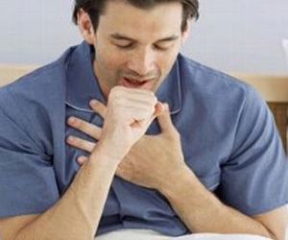
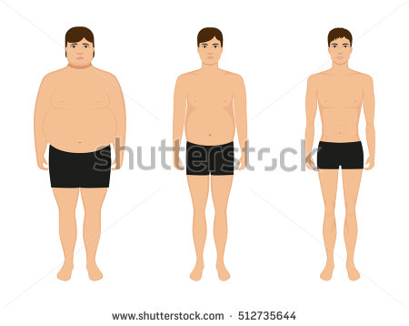


SYMPTOMS
Chest pain, or pain with breathing & coughing
Loss of weight
Lose of appetite
Night sweats

Slide 10


Hello! I’m a public health officer
Case briefing :
Hello!! I’m a public health officer
vaccination
HIV prevention
Breastfeeding tips
TB treatment and follow up

Slide 11
IDENTIFIED PROBLEMS
conservative society
Male dominating society
Lack of knowledge
No social awareness
Stigma in the community
No education

Slide 13
PROPOSED SOLUTION
Increasing Literacy Rate
Social awareness
Reducing Male Dominance
Empowering and motivating all to take free TB service

Slide 14
Social Awareness
R
advertising on different media
Arranging seminar
Plays with morals
Woman education

Slide 15

ENCOURAGE SCHOOL-GOING
HOLD SEMINARS ON IMPORTANCE OF EDUCATION
DEPENDENCE OF HEALTH ON EDUCATION
Improving Literacy Rate

Slide 16
Family breakup
TB is fatal , affect is organ
Severe lung damage if not treated

Slide 17


ENCOURAGEMENT (to go to clinic)
CONSULTING WITH EXPERT DOCTORS
BRINGING CLINIC TO COMMUNITY(2 points)
MALE SHOULD ENCOURAGE FEMALE TO GO TO CLINIC
PRIORITY TREATMENT ON OTHER DISEASES

Slide 18
Male dominance
A male-dominated society is one that benefits men in laws, education, academia and day-to-day life
Reduction of male dominance
Clearing misconception on religion
Participation of woman in earning
Changing woman’s mentality
Move towards openmindedness

